Slide 1

(AUTONOMOUS) Affiliated to JNTUH, Approved by AICTE, Accredited by NAAC with A++ Grade, ISO 9001:2015 Certified Kacharam, Shamshabad, Hyderabad – 501218, Telangana, India DEPARTMENT OF COMPUTER SCIENCE AND ENGINEERING
Title: Electric Vehicle Sentiment Analysis using LLMs
BATCH ID : 22PWCS-B01
S. No | Roll. No | Student Name
1 | 24885A0524 | Gattumidi Yogitha
2 | 23881A05Q0 | Salandri Rishikesh Yadav
3 | 23881A05K7 | Balthu Vikshith
Guide Details
Dr S V Vasantha
Associate Professor
Department of CSE

Slide 2

Project Work Phase-II Review-I Outlines
Main idea of the Project
Existing System Vs Proposed
Proposed Project Objectives
Proposed Project Outcomes
Software and Hardware Requirements
Process Model
Design Phase
Architectural Diagram [Modified]
[UML Diagrams or Data Flow Diagrams] and ER-Diagrams ; It should be detailed diagrams
Proposed Method s and Algorithms [ With example]
Test Cases
Result Analysis [ It should be Table format comparing Existing and Proposed Method Outputs with Graphs]
Output Screens
Conclusion
Future Scope
References
Status of Paper Publication

Slide 3
Main idea of the Project
Main Idea of the Project-
Brain tumors are among the most severe neurological diseases and a major cause of cancer-related deaths; MRI is the preferred imaging modality for diagnosis.
Manual interpretation of MRI scans is time-consuming, labour-intensive, and highly dependent on radiologist skill.
This project proposes a hybrid deep learning framework combining ConvNeXt-Base, EfficientNetB4 and a CBAM attention module for automated brain tumor classification.
MRI images are classified into four categories: Glioma, Meningioma, Pituitary Tumor, and No Tumor.
Goal: build an accurate, generalizable computer-aided diagnostic (CAD) tool to support clinical decision-making.

Slide 4
Existing System Vs Proposed
Existing System
Uses single-backbone deep learning models:
ResNet, VGG16, EfficientNet, Vision Transformer, ConvNeXt
Limitations:
No feature fusion or attention mechanism
High computational cost, dataset-sensitive
Miss either global context or fine local detail
Proposed System
Dual-branch architecture: ConvNeXt-Base + EfficientNetB4
Features:
Captures global structure + fine-grained tumor detail
CBAM channel + spatial attention for informative regions
Feature fusion for a comprehensive representation
99.75% validation accuracy, 95.58% test accuracy

Slide 5
Proposed Project Objectives
Proposed Project Objectives
To design a dual-branch deep learning architecture combining ConvNeXt-Base and EfficientNetB4 for brain tumor classification.
To integrate a CBAM (channel + spatial) attention mechanism to improve feature representation.
To classify MRI images into four categories: Glioma, Meningioma, Pituitary Tumor, No Tumor.
To evaluate the model on validation and independent test sets and benchmark against existing architectures.
To provide a reliable, generalizable computer-aided diagnostic (CAD) tool for clinical decision support.

Slide 6
Proposed Project Outcomes
Proposed Project Outcomes
High-accuracy multi-class brain tumor classification — 99.75% validation accuracy, 95.58% accuracy on an independent test set.
Balanced Precision, Recall and F1-score (99.75%) across all four tumor classes.
Robust feature representation through global + local feature fusion with attention refinement.
Benchmarked performance against ResNet50, VGG16, EfficientNetB4, Vision Transformer, U-Net and ConvNeXt+CBAM.
A generalizable CAD tool to assist radiologists in faster, more consistent tumor detection.

Slide 7
Software and Hardware Requirements
Software and Hardware Requirements
Software
Python
Deep learning framework (PyTorch / TensorFlow-Keras)
Image processing: OpenCV / Pillow
NumPy, scikit-learn (evaluation metrics)
Matplotlib / Seaborn (visualization)
Hardware
System with:
Minimum 16GB RAM
GPU (recommended for training ConvNeXt-Base / EfficientNetB4 backbones)
Sufficient storage for the MRI dataset (7,000+ images)

Slide 8
Process Model
Process Model
Data Collection (Social Media APIs)
Data Preprocessing— resizing, pixel normalization, train / validation / test split
Dual-Branch Feature Extraction — ConvNeXt-Base (global) + EfficientNetB4
CBAM Attention Refinement — channel and spatial attention
Feature Fusion & Classification — concatenation, dense layers, softmax
Model Training & Evaluation — Adam optimizer, categorical cross-entropy loss, accuracy/precision/recall/F1

Slide 9
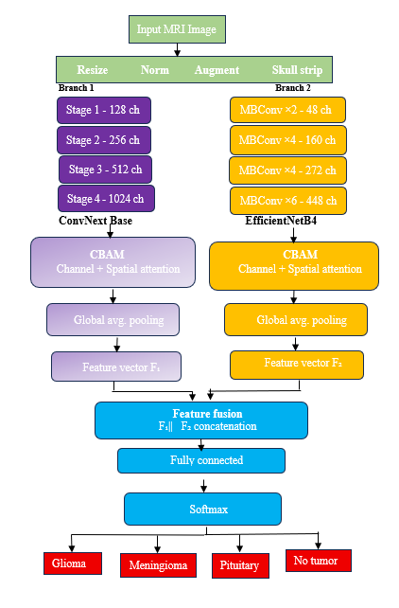
Architectural Diagram
Architectural Diagram

Slide 10
PROPOSED METHOD AND ALGORITHMS

Slide 11
RESULTS [Table format comparing Existing and Proposed Method Outputs with Graphs]
Feature | VGG16 | ResNet50 | EfficientNetB4 | ViT | ConvNeXt-Base + CBAM | Proposed model
Backbone(s) used | Single (VGG16) | Single (ResNet50) | Single (EfficientNetB4) | Single (ViT) | Single (ConvNeXt-Base) | Dual-branch (ConvNeXt-Base + EfficientNetB4)
Attention mechanism | No | No | No | Self-attention | CBAM (channel + spatial) | CBAM (channel + spatial)
Feature fusion | No | No | No | No | No | Yes
Validation accuracy (%) | 90.1 | 91.2 | 94.3 | 95.1 | 95.6 | 99.8
F1-score (%) | 87.5 | 89.5 | 92.5 | 93.5 | 94.8 | 99.8
Independent test accuracy | 95.2% | 97.4% | 98.8% | 98.2% | 95.8 | 95.58%
Generalization | Low | Avg | Good | Very Good | Excellent | Outstanding

Slide 12
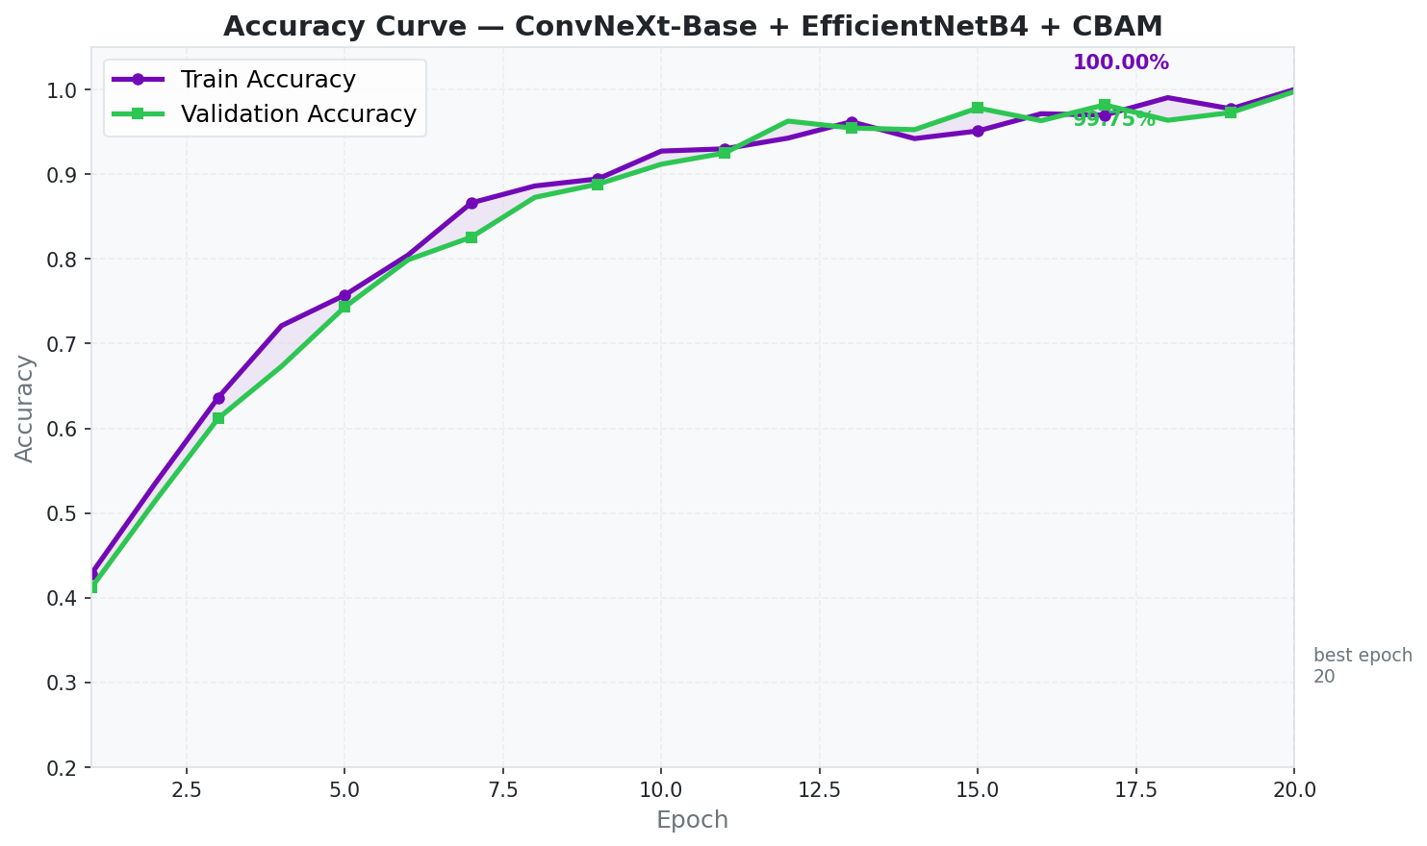
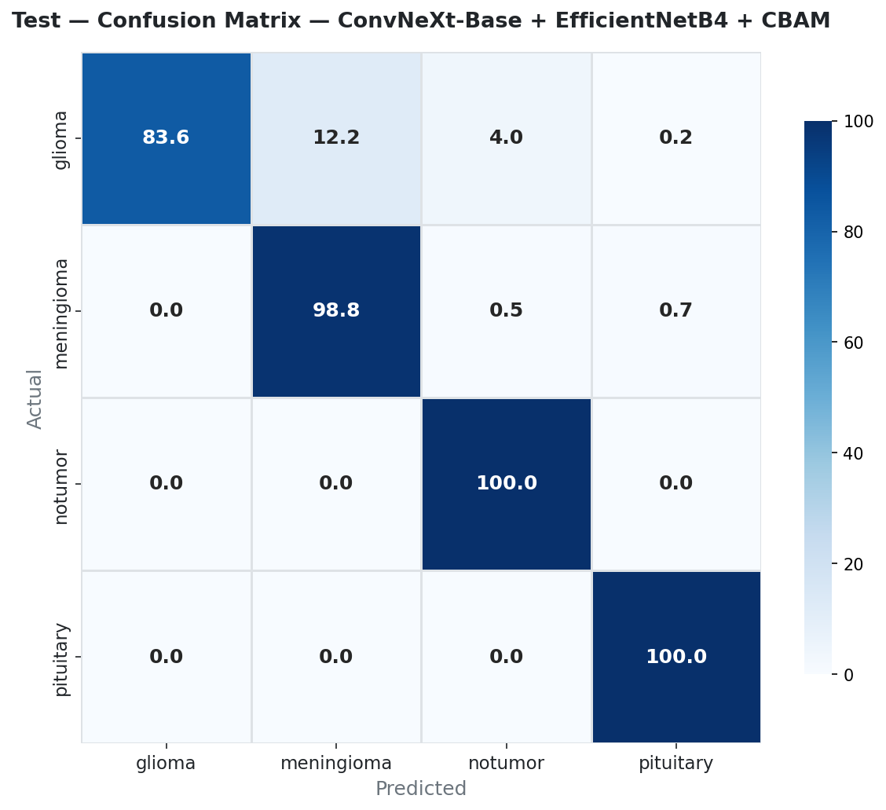
RESULTS [Table format comparing Existing and Proposed Method Outputs with Graphs]
Fig. 1 — Accuracy curve over 20 epochs Fig. 2 — Normalized confusion matrix, test set
DEPARTMENT OF CSE PROJECT WORK PHASE-II FINAL REVIEW

Slide 13
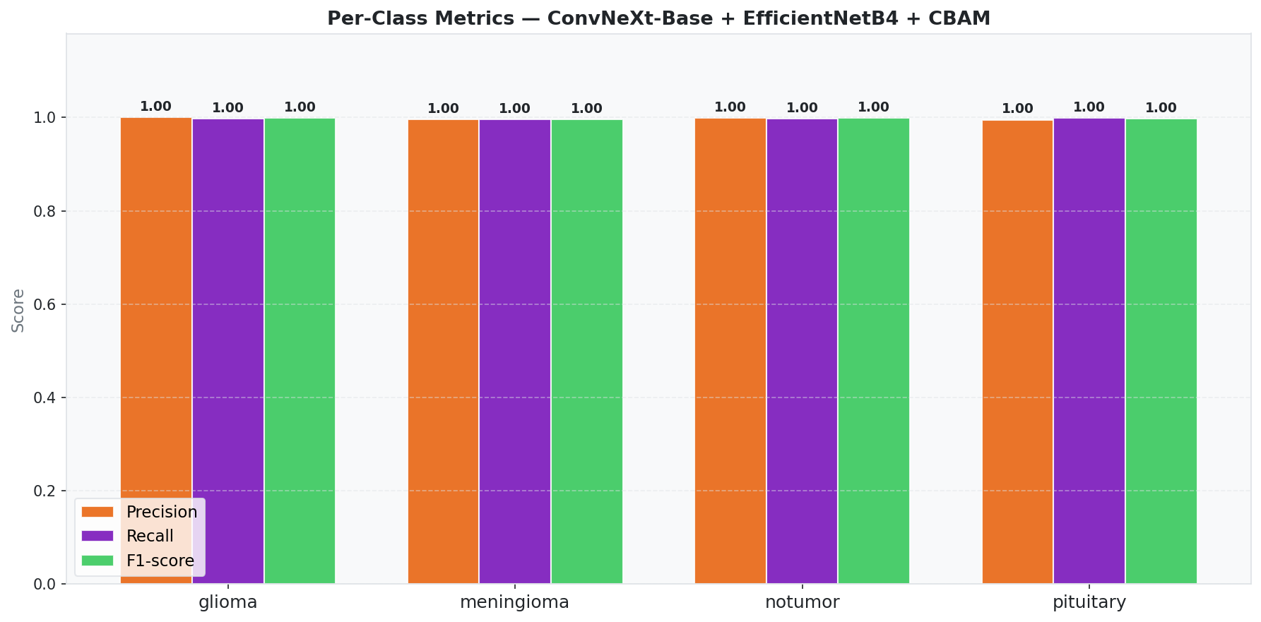
RESULTS [Table format comparing Existing and Proposed Method Outputs with Graphs]
Fig. 3 — Per-class precision, recall and F1-score
DEPARTMENT OF CSE PROJECT WORK PHASE-II FINAL REVIEW

Slide 14
CONCLUSION
This project presents a hybrid dual-branch deep learning model for automated brain tumor classification from MRI images, combining ConvNeXt-Base and EfficientNetB4 with a CBAM attention module. Fusing global structural features with fine-grained local details, and refining them with channel and spatial attention, allows the model to focus on the most informative tumor regions. The framework achieved a validation accuracy of 99.75% and an independent test accuracy of 95.58%, with strong precision, recall and F1-scores across all four tumor categories (Glioma, Meningioma, Pituitary Tumor, No Tumor). These results demonstrate the model's robustness and generalization on unseen data, supporting its potential as a reliable computer-aided diagnostic tool to assist clinicians in early brain tumor detection and treatment planning.

Slide 15
FUTURE SCOPE
Reduce computational complexity to enable real-time clinical deployment.
Validate the model on larger, multi-center MRI datasets to improve generalizability.
Incorporate Explainable AI (XAI) methods to improve model interpretability and clinician trust.
Extend the framework to brain tumor segmentation, not just classification.
Deploy the model in web/mobile healthcare applications for practical clinical use.

Slide 16
REFERENCES

Slide 17
STATUS OF PAPER PUBLICATION
Completed the research paper and have applied for IEEE conferences.

Slide 18
Thank You

